Slide 1
INTERNETWORKING

Slide 2
Internetworking
Networks differ in various ways, so when multiple networks are interconnected problems can occur.
Sometimes the problems can be finessed by tunneling a packet through a hostile network, but if the source and destination networks are different, this approach fails.
When different networks have different maximum packet sizes, fragmentation may be
called for.

Slide 3
Internetworking
How Networks Differ
How Networks Can Be Connected
Concatenated Virtual Circuits
Connectionless Internetworking
Tunneling
Internetwork Routing
Fragmentation

Slide 4
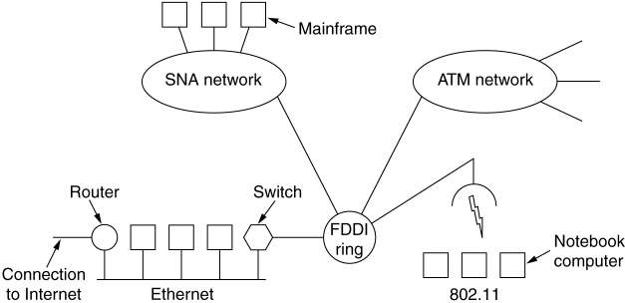
Internetworking Connecting Networks
A collection of interconnected networks.

Slide 5
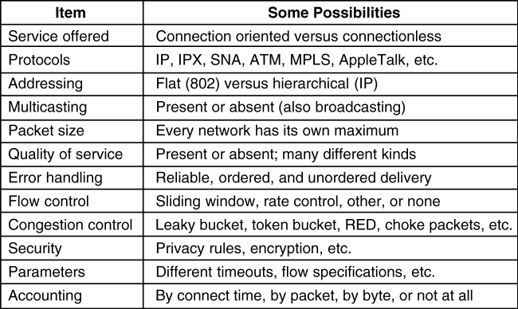
Internetworking How Networks Differ
5-43
Some of the many ways networks can differ.

Slide 6
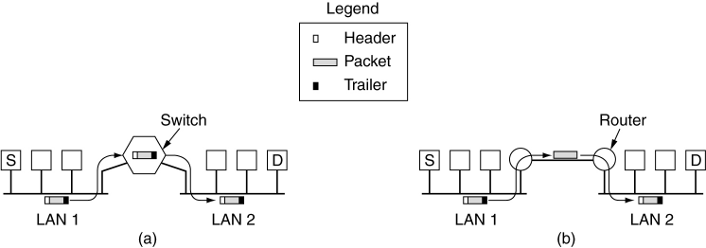
How Networks Can Be Connected
Two Ethernets connected by a switch.
Two Ethernets connected by routers.

Slide 7
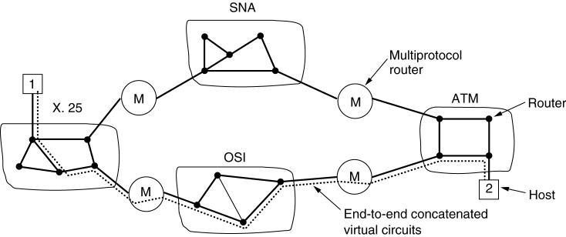
Concatenated Virtual Circuits
Internetworking using concatenated virtual circuits.

Slide 8
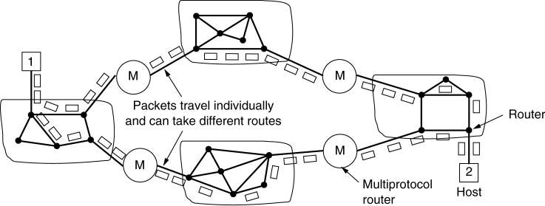
Connectionless Internetworking
A connectionless internet.

Slide 9
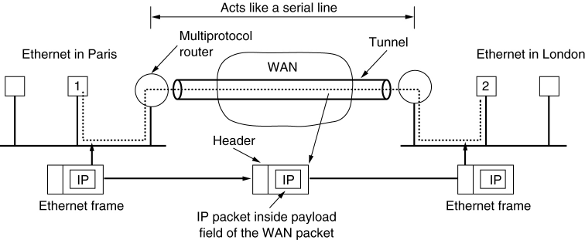
Tunneling
Tunneling a packet from Paris to London.

Slide 10
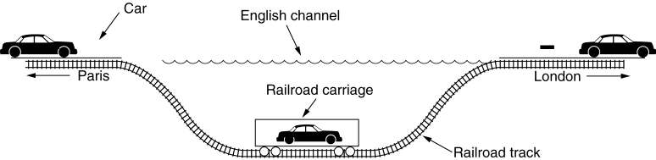
Tunneling
Tunneling a car from France to England.

Slide 11
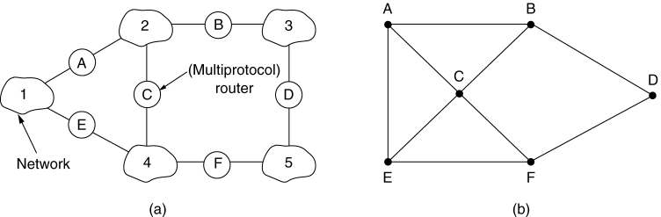
Internetwork Routing
(a) An internetwork.
(b) A graph of the internetwork.

Slide 12
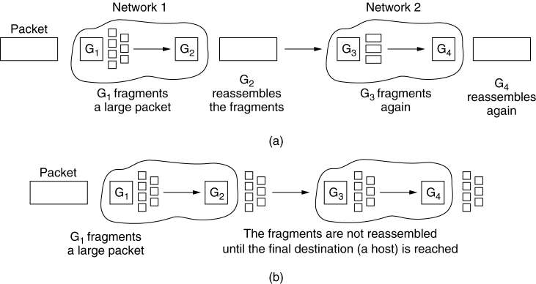
Fragmentation
(a) Transparent fragmentation.
(b) Nontransparent fragmentation.

Slide 13
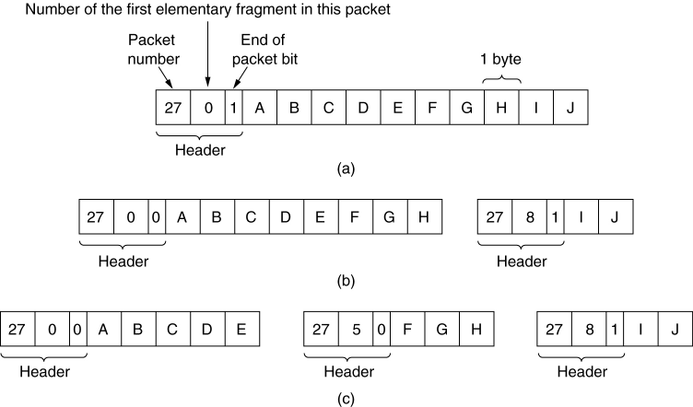
Fragmentation
Fragmentation when the elementary data size is 1 byte.
Original packet, containing 10 data bytes.
Fragments after passing through a network with maximum packet size of 8 payload bytes plus header.
Fragments after passing through a size 5 gateway.

Slide 14
IPv4
The Internet Protocol version 4 (IPv4) is the delivery mechanism used by the TCP/IP protocols.
Characteristics
IPv4 is an unreliable and connectionless datagram protocol – a best effort delivery
Best effort means that IPv4 provides no error control (except for error detection on the header) or flow control
IPv4 does its best to get a transmission through to its destination, but with no guarantees

Slide 15
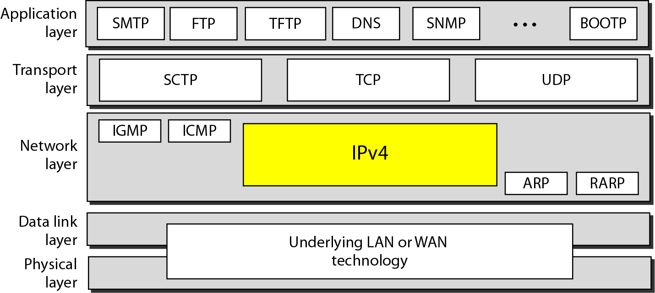
Position of IPv4 in TCP/IP protocol suite

Slide 16
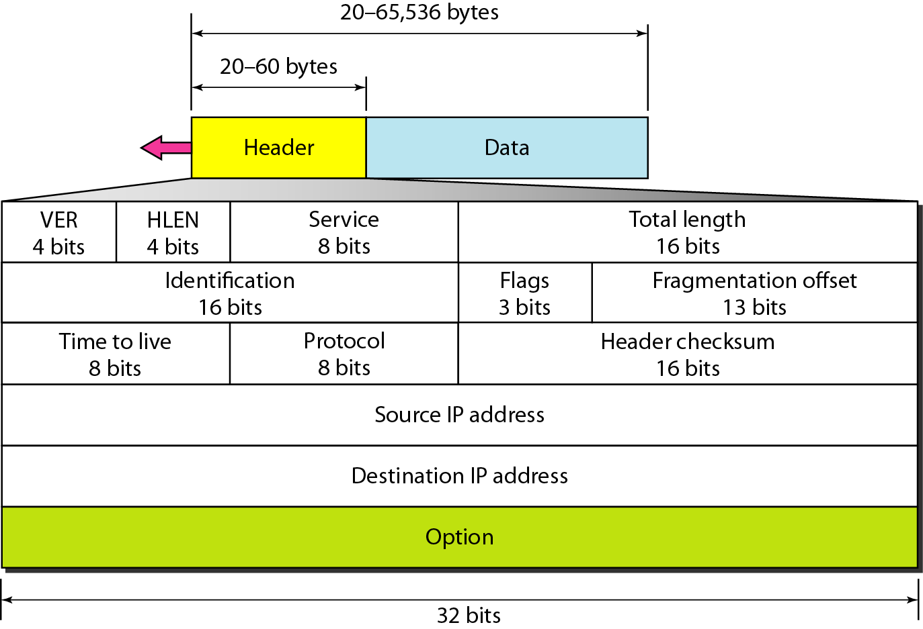
IPv4 datagram format

Slide 17
IPv4 Datagram Format
Version (VER): version of the IP protocol. Currently, the version is 4.
Header length (HLEN): the total length of the datagram header in 4-byte words.
Services: service type or differentiated services (not used now).
Total length: total length (header plus data) of the datagram in bytes.
Total length of data = total length – header length

Slide 18
IPv4 Datagram Format
Identification: used in fragmentation (discussed later).
Flags: used in fragmentation (discussed later).
Fragmentation offset: used in fragmentation (discussed later).
Time to live: it is used to control the maximum number hops visited by the datagram.
Protocol: defines the higher-level protocol that uses the services of the IPV4 layer.

Slide 19
IPv4 Datagram Format
Checksum: 1’s compliment checksum.
Source address: is the IPv4 address of the source.
Destination address: is the IPv4 address of the source.
The total length field defines the total length of the datagram including the header.

Slide 20
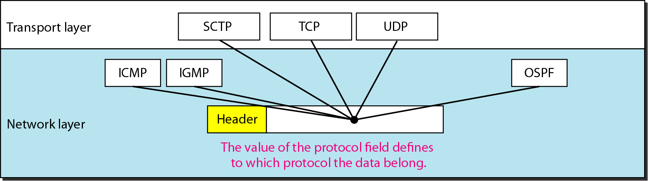
Protocol field and encapsulated data

Slide 21
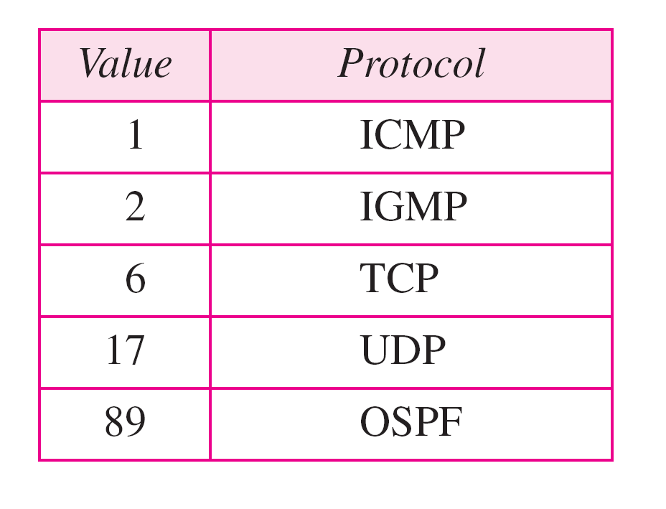
Protocol values

Slide 22
Fields Related to Fragmentation
Identification: identifies a datagram originating from the source host. A combination of the identification and source address must uniquely define a datagram as it leaves the source node.
Flags: see next slide.
Fragmentation offset: is the offset of the data in the original datagram measured in units of 8 bytes.

Slide 23

Flags (3 bits) used in fragmentation
first bit: reserved (not used)
second bit: = 1 requires the packet not to be fragmented
drops the packet if it is > MTU
third bit: =1 more fragmented packets later
=0 the last fragmented packet

Slide 24
IPv4 Checksum
IPv4 checksum use the 1’s compliment method (chapter 10)
Checksum only computes for IP header, not data
Upper layer has checksum for data portion
Header always changes in each router
Header is chunked to 16-bit sections for computing

Slide 25
IPv6
The network layer protocol in the TCP/IP protocol suite is currently IPv4.
Although IPv4 is well designed, data communication has evolved since the inception of IPv4 in the 1970s.
IPv4 has some deficiencies that make it unsuitable for the fast-growing Internet.

Slide 26
IPv6: ADVANTAGES
Larger address space.
Better header format.
New options.
Allowance for extensions.
Support for resource allocation.
Support for more security.

Slide 27
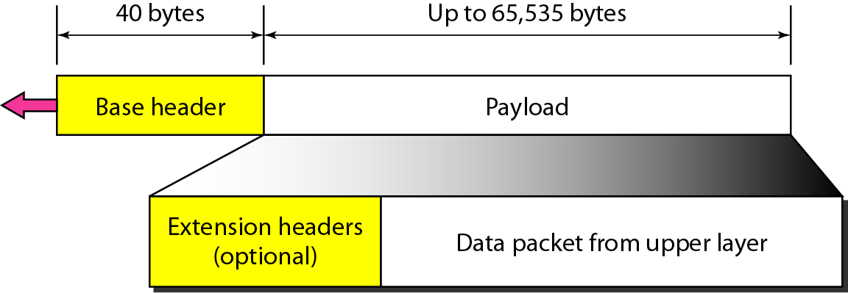
IPv6 datagram header and payload

Slide 28
TRANSITION FROM IPv4 TO IPv6
Because of the huge number of systems on the Internet, the transition from IPv4 to IPv6 cannot happen suddenly. It takes a considerable amount of time before every system in the Internet can move from IPv4 to IPv6. The transition must be smooth to prevent any problems between IPv4 and IPv6 systems.

Slide 29
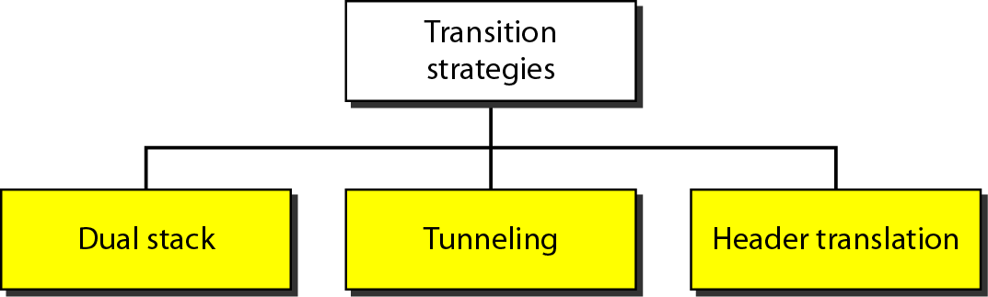
Three transition strategies

Slide 30
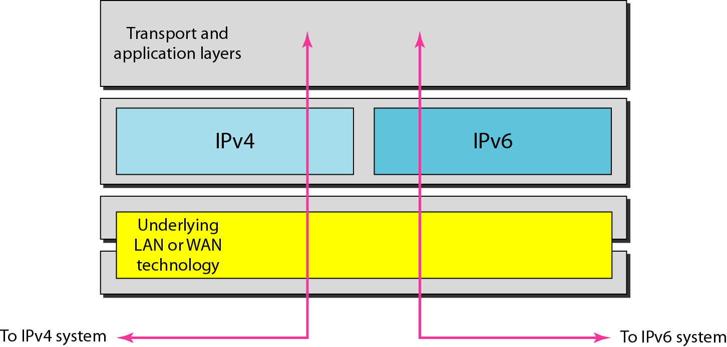
Dual stack
Host uses DNS query result to determine which IP to use

Slide 31
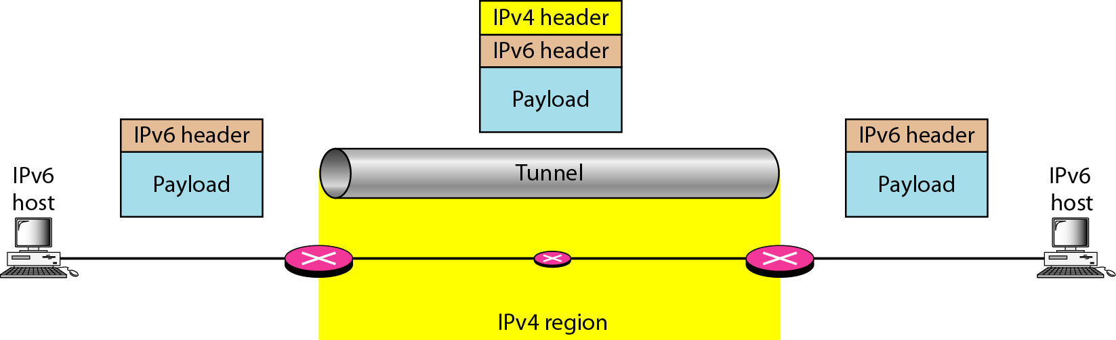
Tunneling strategy
Popular used right now in many countries

Slide 32
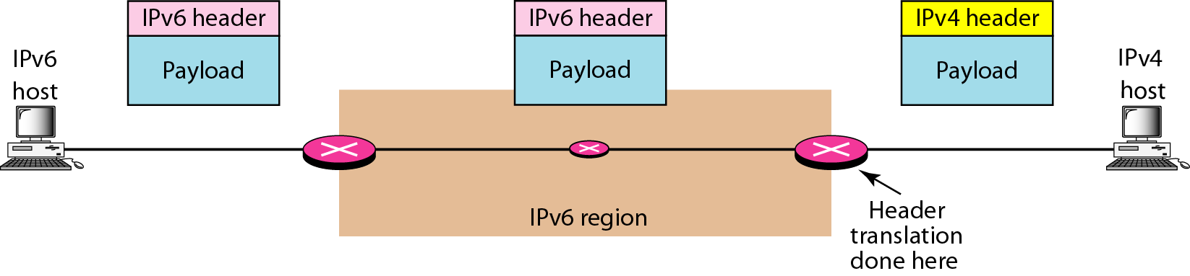
Header translation strategy

Slide 33
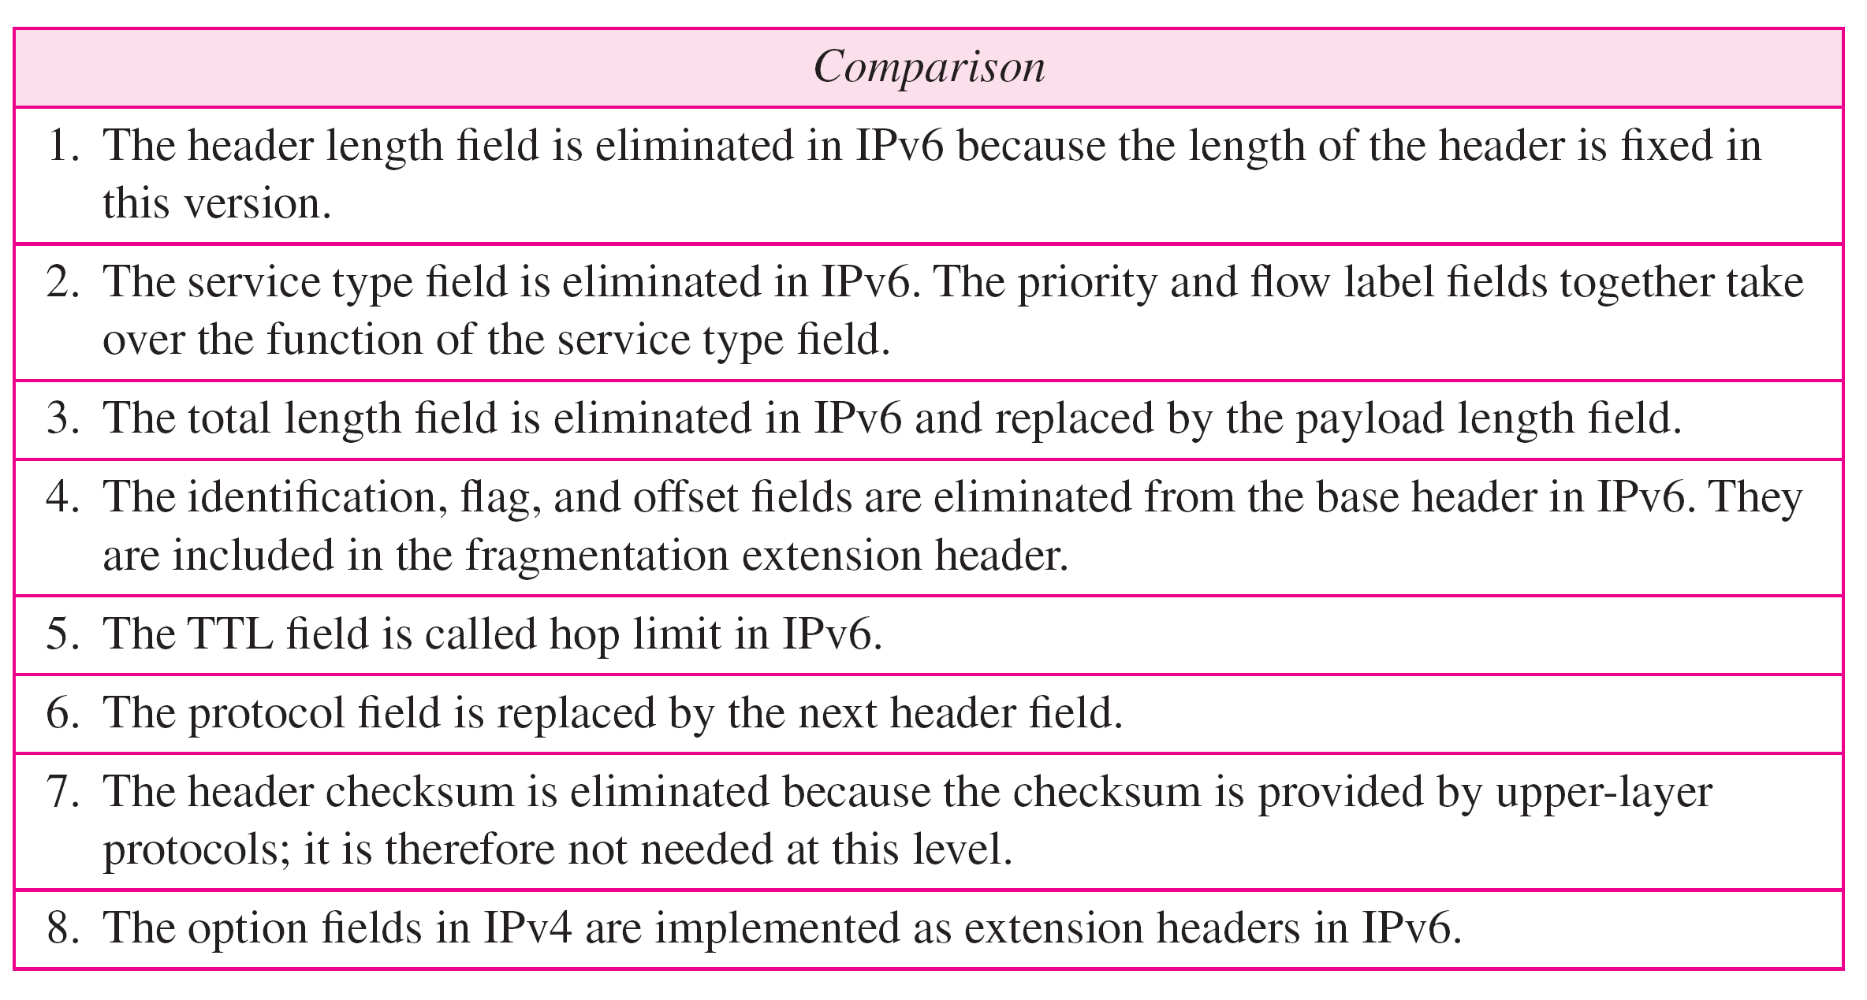
Comparison between IPv4 and IPv6 packet headers

Slide 34
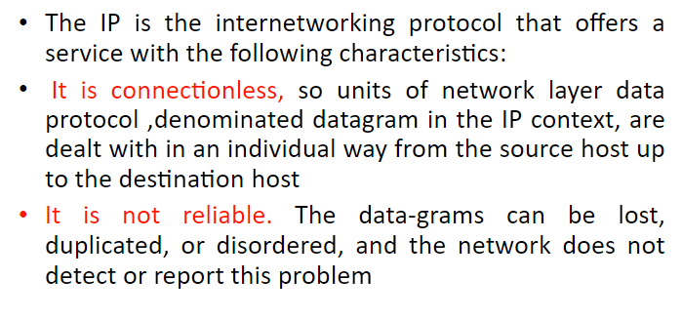
IP

Slide 35
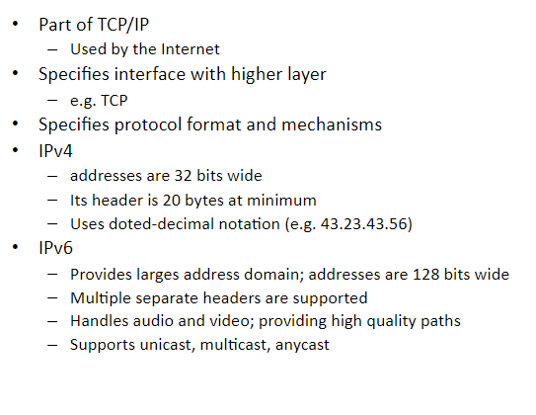
IP

Slide 36
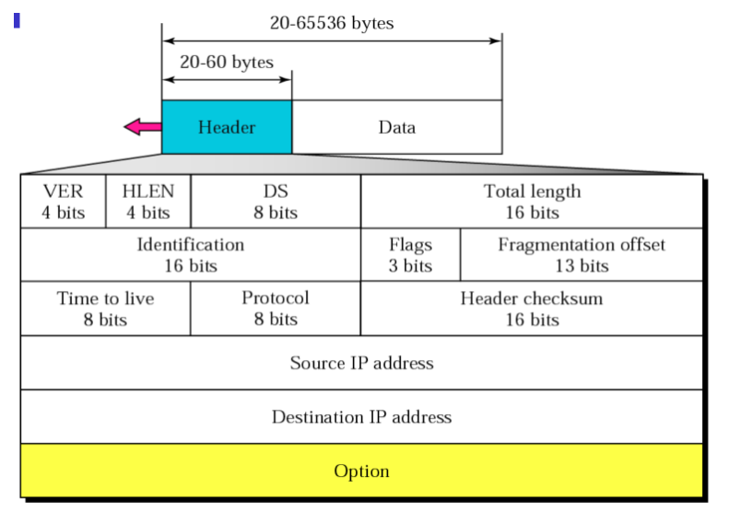
IP DATAGRAM

Slide 37
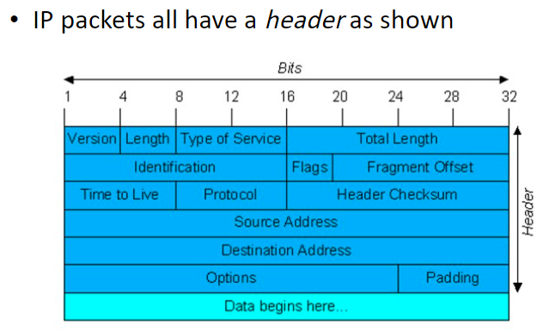
THE IP PROTOCOL

Slide 38
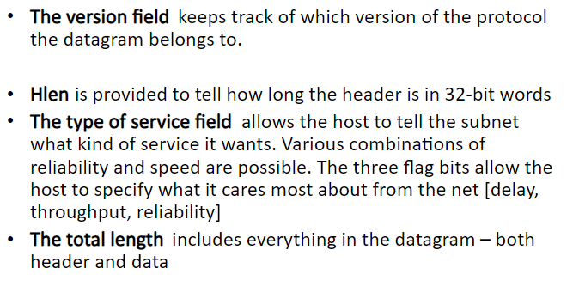
IP HEADER FORMAT

Slide 39
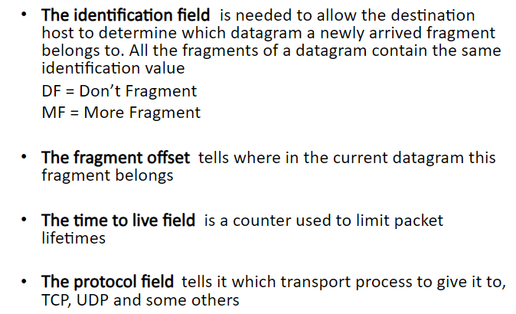
IP HEADER FORMAT

Slide 40
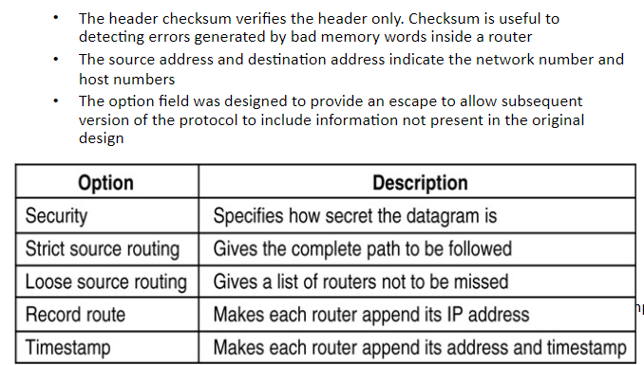
IP HEADER FORMAT

Slide 41
IP Addresses
Every host and router on the internet has an IP ADDRESS, which encodes its NETWORK NUMBER and HOST NUMBER.
The combination is unique: in principle, no two machines on the internet have the same IP address.

Slide 42
IP Addresses
All IP addresses are 32 bits long and are used in the SOURCE ADDRESS and DESTINATION ADDRESS fields of IP
packets.
For several decades, IP addresses were divided into the FIVE CATEGORIES.
This allocatıon has come to be called CLASSFUL ADDRESING.

Slide 43
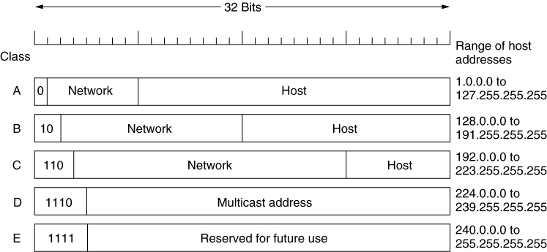
IP Addresses
IP address formats.

Slide 44
IP Addresses
CLASS A format allows for up to 128 networks with 16 million hosts each, B - 16,384 networks with up to 64K hosts, C - 2 million networks (e.g., LANs) with up to 256 hosts each (although a few of these are special), and D is multicast, in which a datagram is directed to multiple hosts.

Slide 45
IP Addresses
Addresses beginning with 1111 are reserved for future use.
Over 500,000 networks are now connected to the Internet, and the number grows every year.
Network numbers are managed by a nonprofit corporation called ICANN (Internet Corporation for Assigned Names and Numbers) to avoid conflicts.

Slide 46
IP Addresses
Network addresses, which are 32-bit numbers, are usually written in DOTTED DECIMAL NOTATION .
In this format, each of the 4 bytes is written in decimal, from 0 to 255.
The lowest IP address is 0.0.0.0 and the highest is 255.255.255.255

Slide 47
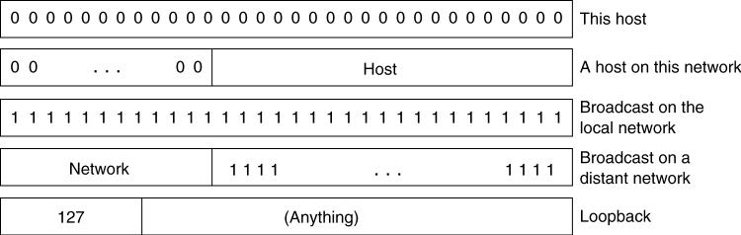
IP Addresses
Special IP addresses.

Slide 48
IP Addresses
The value 0 and -1 (all 1s) have special meanings.
The value 0 means this network or this host.
The value of -1 is used as a broadcast address to mean all hosts on the indicated network.

Slide 49
CIDR – Classless InterDomain Routing
The basic idea of CIDR is to allocate the remaining IP addresses in variable – sized blocks, without regard to the classes.
Dropping the classes makes forwarding more complicated.

Slide 50
CIDR – Classless InterDomain Routing
In the old classful system, forwarding worked like this. When a packet arrived at a router, a copy of the IP address was shifted right 28 bits to yield a 4-bit class number.
Once the entry was found, the outgoing line could be looked up and the packet forwarded.

Slide 51
CIDR – Classless InterDomain Routing
With CIDR, this simple algorithm no longer works.
Instead, each routing table entry is extended by giving it a 32-bit mask.
Thus, there is now a single routing table for all networks consisting of an array of (IP address, subnet mask, outgoing line) triples.

Slide 52
CIDR – Classless InterDomain Routing
When a packet comes in, its destination IP address is first extracted.
Then the routing table is scanned entry by entry, masking the destination address and comparing it to the table entry looking for a match.

Slide 53
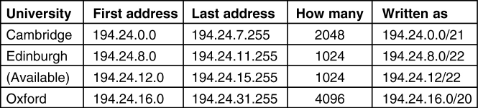
CIDR – Classless InterDomain Routing
5-59
A set of IP address assignments. The routing tables all over the world are now updated with the three assigned entries.
ADRESS | MASK
C:11000010 00011000 00000000 00000000 | 1-1 1-1 11111000 0-0
E:11000010 00011000 00001000 00000000 | 1-1 1-1 11111100 0-0
O:11000010 00011000 00010000 00000000 | 1-1 1-1 11110000 0-0

Slide 54
INTERNET CONTROL PROTOCOLS
In addition to IP, which is used for data transfer, the internet has several control protocols used in the network layer, including ICMP, ARP, RARP, BOOTP, and DHCP.

Slide 55
ICMP - Internet Control Message Protocol
The operation of the Internet is monitored closely by the routers.
When something unexpected occurs, the event is reported by the ICMP, which is also used to test the internet.
About a dozen types of ICMP message are defined.

Slide 56
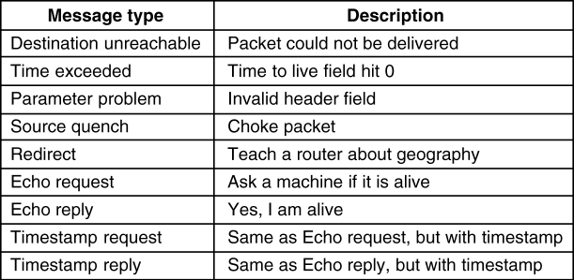
Internet Control Message Protocol
5-61
The principal ICMP message types.

Slide 57
ICMP - Internet Control Message Protocol
Each ICMP message type is encapsulated in an IP packet.
In addition to this messages, others have been defined.

Slide 58
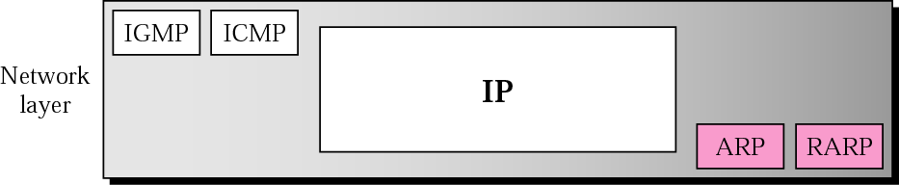
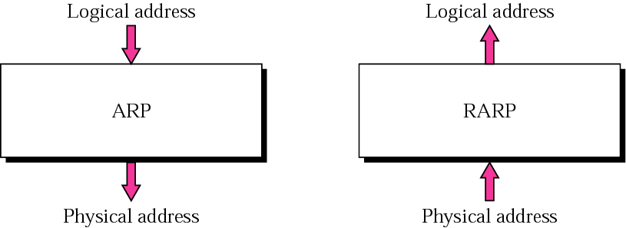
ARP and RARP

Slide 59
ARP
ARP associates an IP address with its physical address.
On a typical physical network, such as a LAN, each device on a link is identified by a physical or station address that is usually imprinted on the NIC.

Slide 60
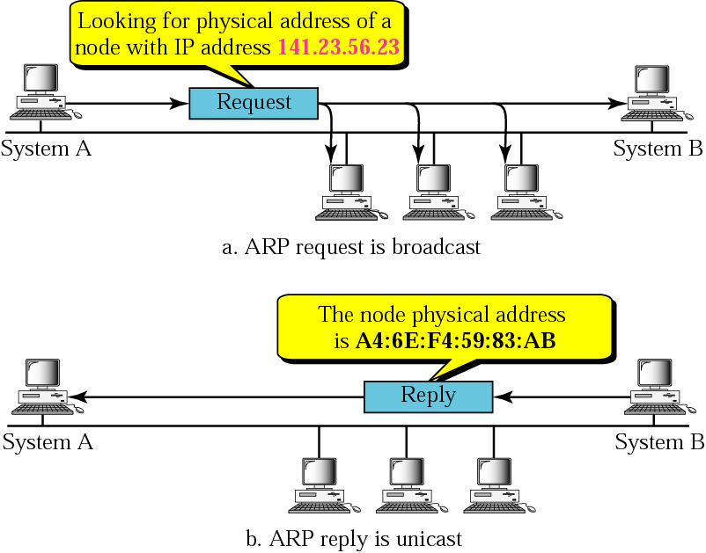
ARP

Slide 61
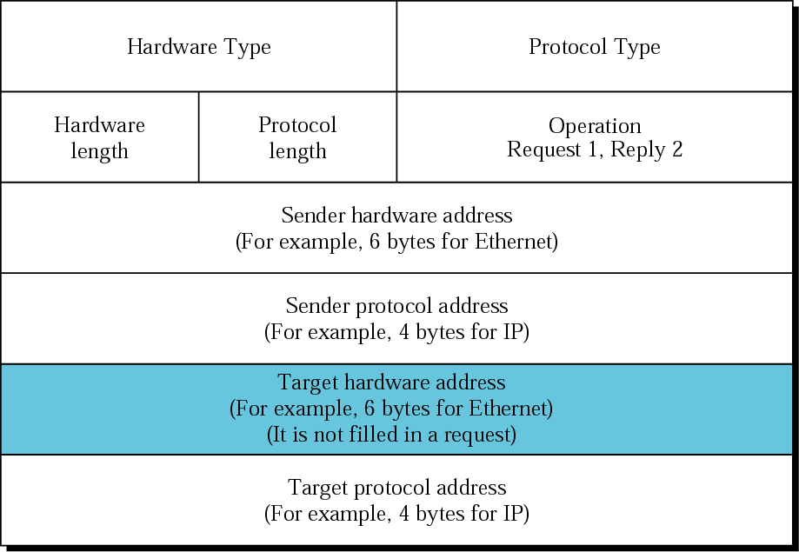
ARP Packet
Network
Type - Ethernet
is type 1(16 bit)
Protocol Type-
IPv4=x0800
Hardware
Length: length of
Ethernet
Address (6)
Protocol
Length: length of
IPv4 address (4)

Slide 62
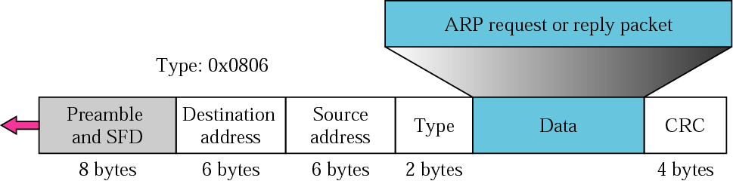
Encapsulating ARP Packet
The ARP packet is encapsulated within an Ethernet packet.

Slide 63
RARP
RARP finds the logical address for a machine that only knows its physical address.
This if often encountered on thin-client workstations. No disk, so when machine is booted, it needs to know its IP address
RARP requests are broadcast, RARP replies are unicast.

Slide 64
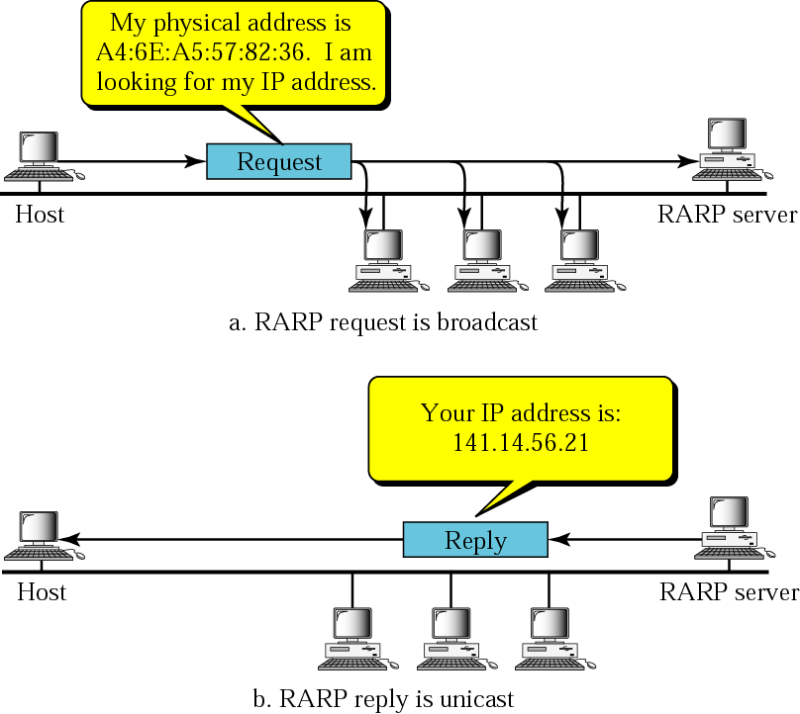
RARP

Slide 65
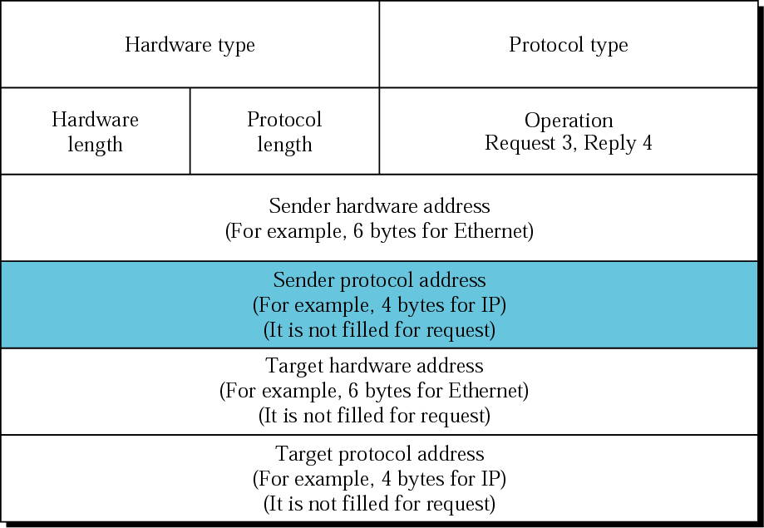
RARP Packet

Slide 66
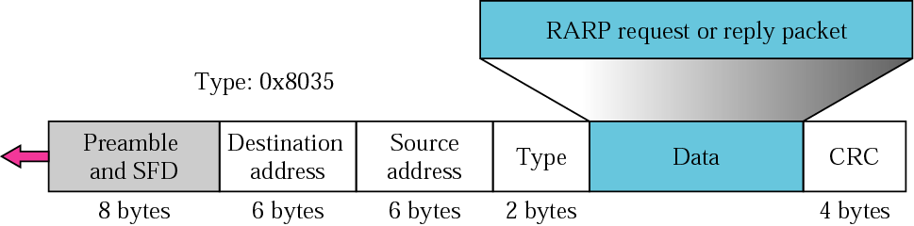
Encapsulation of RARP Packet

Slide 67
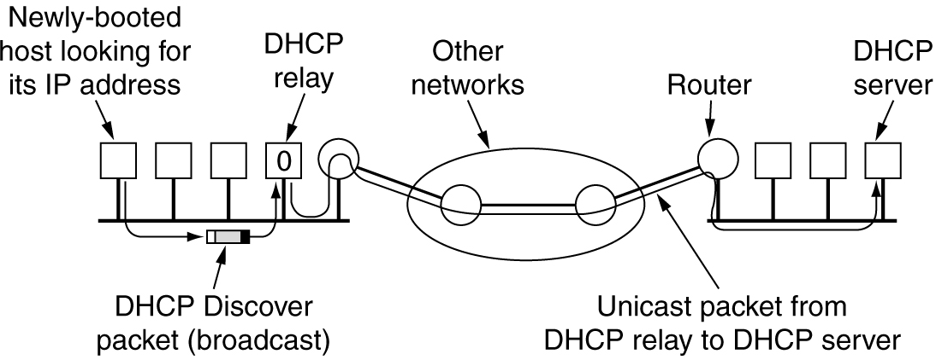
Dynamic Host Configuration Protocol(DHCP)
Operation of DHCP.

